Slide 1
Disclaimer
This training resource was developed to be used with the CZ ID platform
In October, 2026, stewardship of CZ ID transitioned to UCSF and the platform was renamed to SeqtoID
These training materials are not being actively maintained and may not reflect differences between CZ ID and SeqtoID, subsequent changes to the platform, or current methods and best practices in metagenomic sequencing and analysis

Slide 2

Quality Control Overview and Interpretation
Rapid Response – Updated Sept 2026
Notes:
Slides updated 07/02/2024

Slide 3
Steps for Exploring Results
QC metrics
Sample Report
  Metrics
  Analysis
Accounting for background
CZ ID Help Center: Analyzing Nanopore Data

Slide 4
Outline
QC metric definitions
How QC metrics help inform wet lab experiments and data interpretation
Perform QC within CZ ID (look at your data!)

Slide 5
Quality Control
Were there enough reads / bases?
Did my samples pass QC filtering? (basecall quality, length, complexity)
How many reads / bases were removed during data preprocessing? (e.g., host filtering)
How many reads / bases were used for microbe identification?

Slide 6
CZ ID QC Metrics
Total Reads: Total reads uploaded to the pipeline.
Passed QC: Percentage of reads remaining after QC filtering to remove low quality bases (phred score < 9), short reads (< 100 bp), and low complexity reads.
Subsampled Fraction: After QC filtering and host/human data removal, the remaining reads are subsampled to 1 million.
Passed Filters: Reads used for analysis. Percentage of reads that passed QC, host/human filtering, and subsampling compared to the initial reads input.
Note: The Project Page only provides stats at the read level. If you are interested in the base pair level, see the Sample Overview report available through bulk download or look at the pipeline details on the Sample Report page.
Notes:
We like DCR < 3

Slide 7
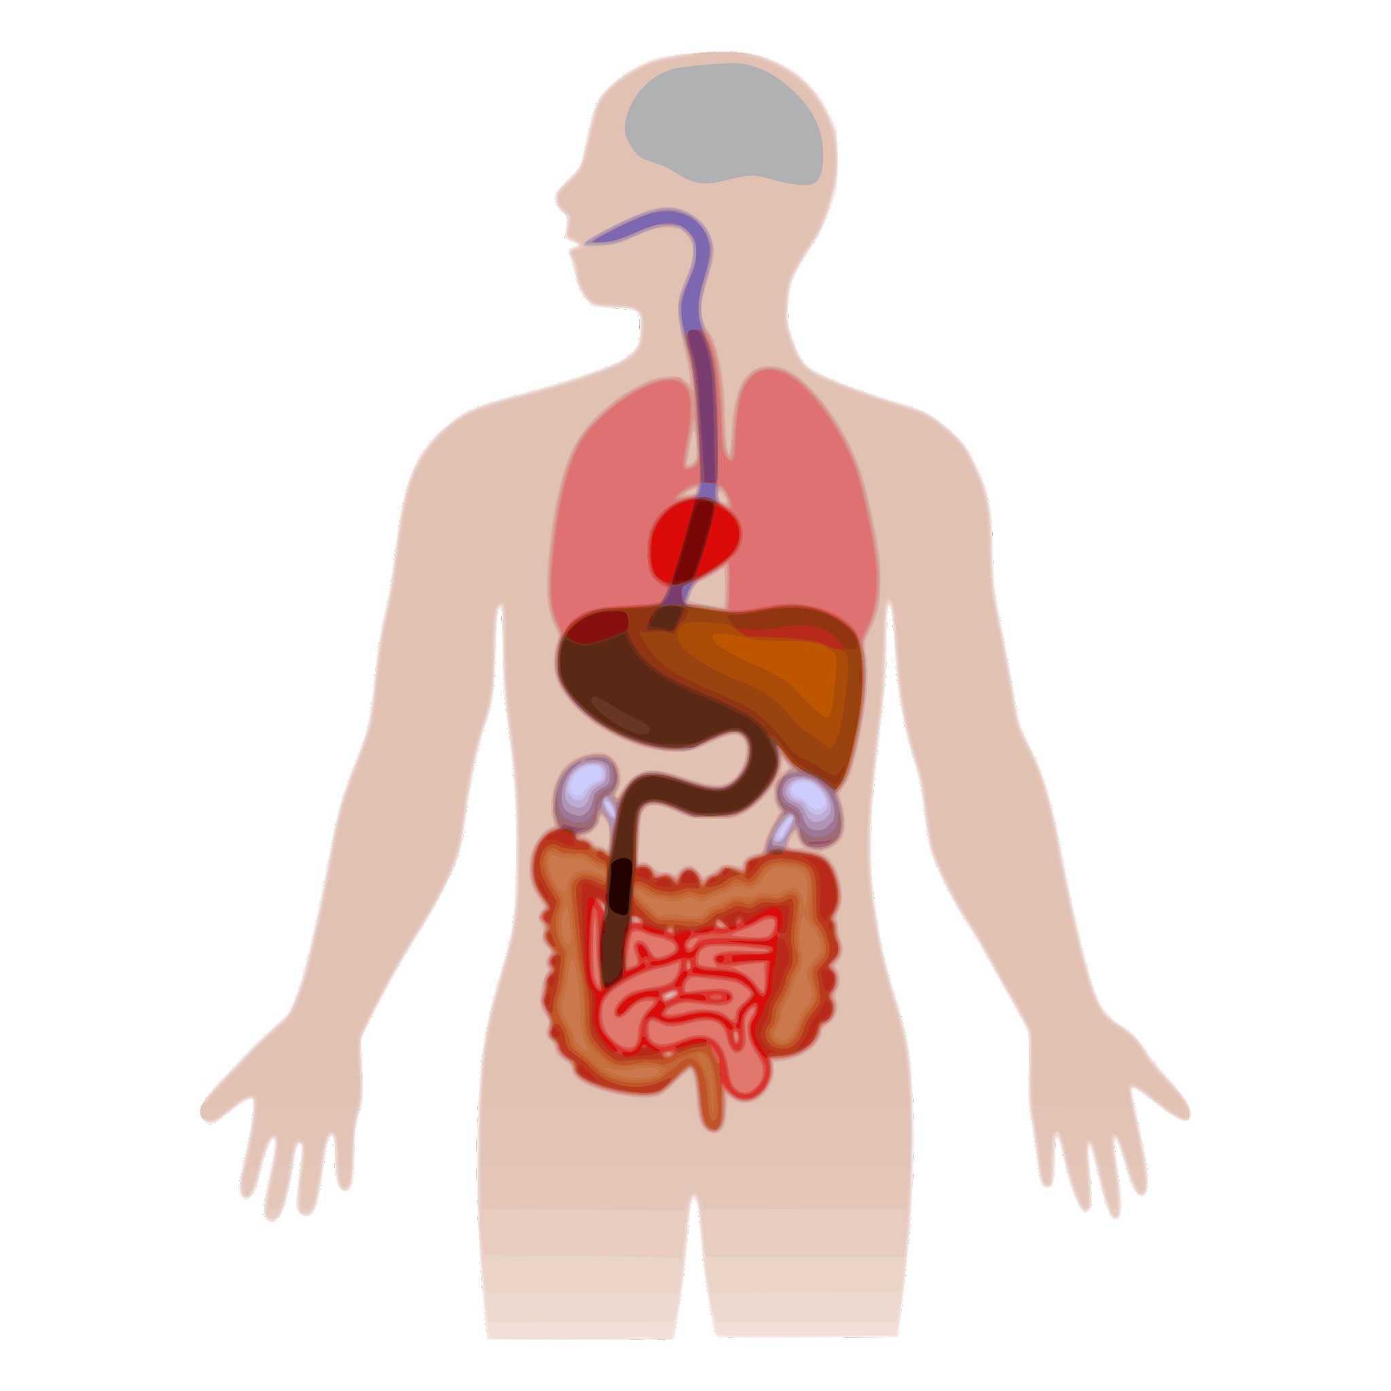
Sample type matters when evaluating QC metrics
Sample Type | Host Signal | Microbial Signal
CSF | > 99% | << 5% with infection
Tracheal Aspirate | 95% | 5%
Nasal or oral | 50% | 50%
Whole blood | > 99% | << 1% (with infection)
Rectal or Vaginal | 50% | 50%
Host
Microbial
Adapted from CZ BioHub mNGS Intro
Notes:
Different sample types have different RNA content host vs microbiome vs pathogen

Slide 8
QC metrics affected by sample type
Sample Type | Typical Distribution | QC Trend
Stool, NP Swab, Environmental Samples, Sputum, Urine (Higher diversity & DNA/cDNA input) |  | Higher microbial reads Lower DCR
Serum, CSF, Plasma, Negative Controls (Lower diversity & DNA/cDNA input) |  | Lower microbial reads Higher DCR (PCR artifact) Higher background contamination
Host
Microbial
ERCC
host
microbe
ERCC
*ERCC evaluation is not available for ONT in CZ ID, however the concepts apply

Slide 9
QC metrics not affected by sample type
% Passed QC (fastp)
  Should not inherently vary by tissue type
    Per base quality (Q score)
    Adapter dimer
    Length
    Complexity
  May require knowledge of sample processing for interpretation
Total reads
  Not affected by sample type
  Dependent on input DNA/cDNA and sequencing depth

Slide 10
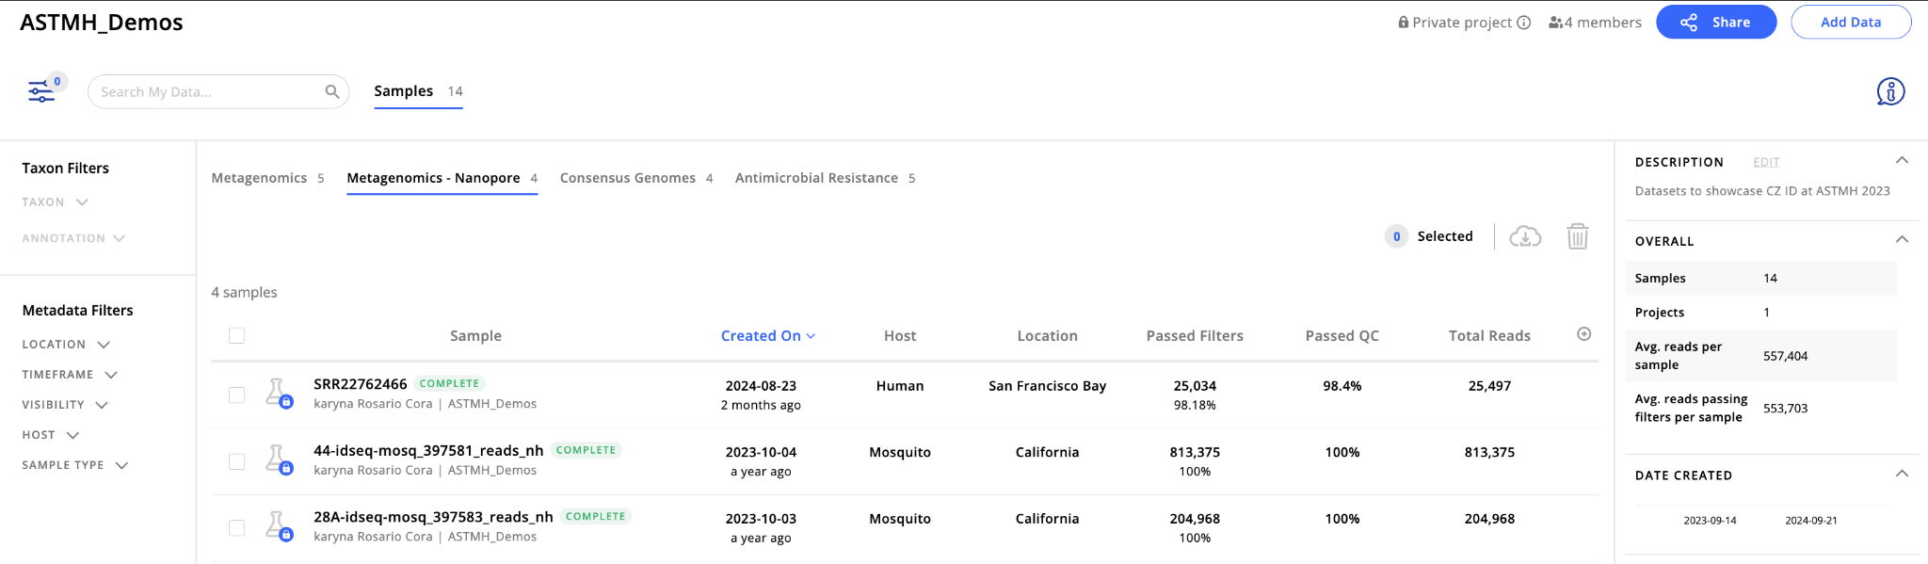
Project Page QC Metrics
Notes:
Find QC metrics in the project page. You can add other metrics and metadata by clicking the “+” button

Slide 11
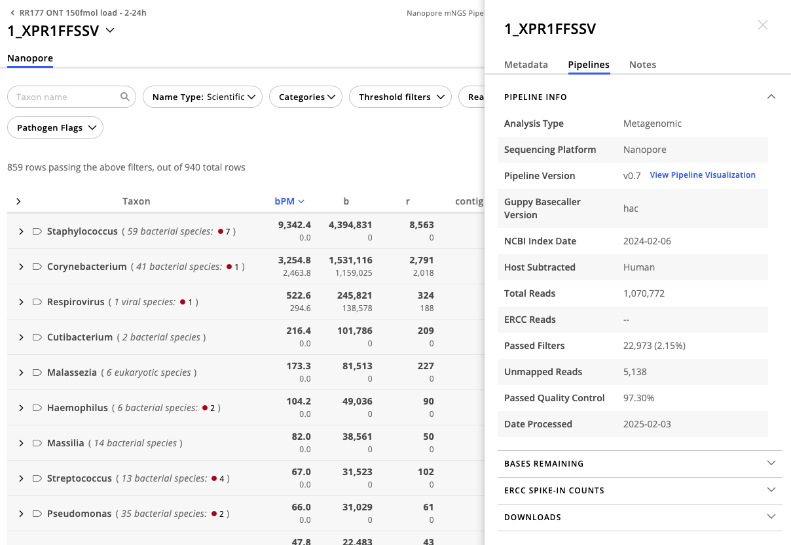
Sample-level QC

Slide 12
Pipeline Table
Pipeline Step | Function | If Many Reads Lost During this Step...
fastp | Low quality read removal Low complexity read removal Note: adapter trimming is not completed in CZID. It must be done in ONT MinKNOW/Dorado, prior to upload to CZID | Many reads of low-quality (Phred scores, GC content); check sequencing run - suggest reviewing sequencing run report Reads are relatively low-complexity, containing homopolymer nucleotides or simple sequence repeats Many short reads: possible degradation, low quality RNA.
minimap2 | Host and human filtering | Large proportion of reads mapped to the host/human reference genome; this will vary by sample type and sample pre-processing
seqkt | Subsampling to reduce computational burden | Sample received a lot of reads during sequencing and/or has a high proportion of reads that are microbial
Notes:
Metrics are accessible through Sample Details -> Pipelines -> Bases remaining

Slide 13
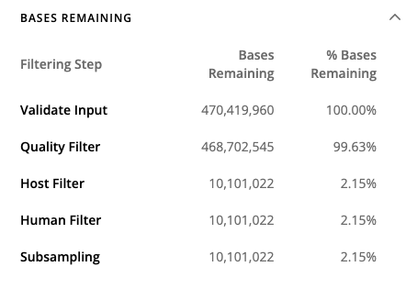
Sample-level QC

Slide 14
Go to worksheet:
Quality control
step 1 to 5
Worksheet: CZ ID Training Reference Tables & Worksheets_ONT, pg 5-9

